Slide 1
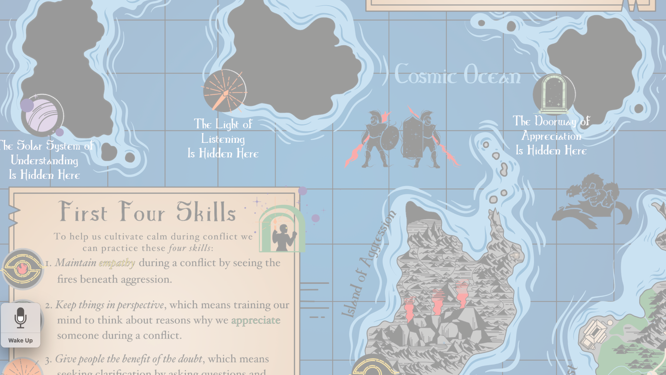
Intro to
Navigating the
Island of Aggression:
The Manual
©️ peaceliteracy.org 2023

Slide 4
Who were Deimos and Phobos?
What is the greatest problem of every army in history?

