Slide 1
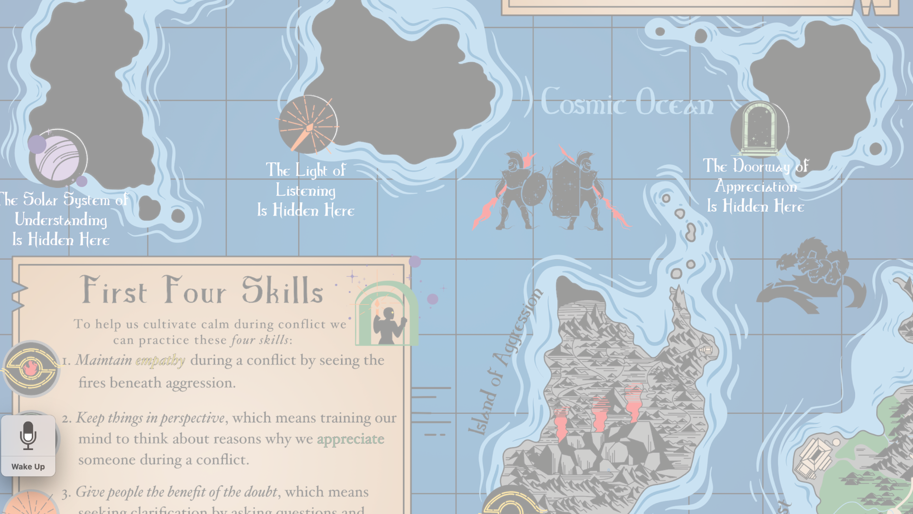
Navigating the
Island of Aggression
3 Skills for Calming
other People Down

Slide 4
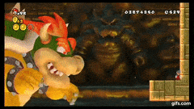

Slide 5
Viruses are contagious
So is Panic
Fear
Calm
Love
Enthusiasm
Kindness
Joy
Choose wisely

Slide 6
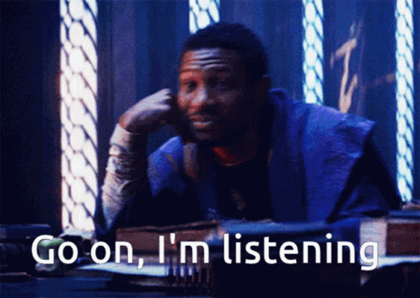

Slide 7
